Slide 1

Sreyas Institute of Engineering and Technology
An Autonomous Institution
Approved by AICTE, Affiliated to JNTUH
Accredited by NAAC-A Grade, NBA (CSE, ECE & ME) & ISO 9001:2015 Certified
REVIEW - I
A PROJECT
ON
BIO-EYE: AN ADVANCED WILDLIFE DETECTION FRAMEWORK
BACHELOR OF TECHNOLOGY
IN
COMPUTER SCIENCE AND ENGINEERING
BY
MAGANTI NIKHIL REDDY 21VE1A0538
PATNAM AKSHITHA REDDY 21VE1A0550
PAGADALA SANDEEPA 21VE1A0546
LINGAMGUNTA HEMANTH 21VE1A0537
ACADEMIC BATCH: (2021-2025)
Under the Guidance of
MRS. K. RAMYA LAXMI – Assistant Professor

Slide 2
Content
Abstract
Existing System
Drawbacks of Existing System
Proposed System
Merits of Proposed System
System Requirements
User Requirements
Architecture Diagram
Modules
UML Diagrams
Testing and Its Types
Test Cases
Outputs
Challenges and Limitations
Future Scope or Enhancements
Conclusion

Slide 3
Abstract
Efficient wildlife monitoring is essential for conservation and management, with camera traps being a key tool for unobtrusive and continuous data collection. However, the manual processing of vast amounts of camera trap imagery is labor-intensive and time-consuming. This paper proposes a framework utilizing deep convolutional neural networks (CNNs) for automated species recognition in the wild, based on a dataset from the Wildlife Spotter project. The system uses advanced graph-cut algorithms to segment images and identifies species automatically, significantly outperforming traditional methods like the bag of visual words model. This approach not only accelerates research and enhances citizen science initiatives but also improves management decisions. While there are challenges related to environmental conditions and species diversity, the proposed method marks a substantial advancement in automated wildlife monitoring. Integrating deep learning with camera trap technology promises to revolutionize ecological research, offering more accurate and efficient species identification and facilitating timely conservation actions.

Slide 4
Existing System
The traditional approach to species recognition in wildlife monitoring relies heavily on manual processing and basic machine learning methods. Camera traps collect large volumes of images and videos continuously, capturing animal activity unobtrusively in their natural habitats. However, manually sorting and classifying these images is highly labor-intensive, time-consuming, and prone to human error. To automate some of this process, simpler machine learning techniques, like the Bag of Visual Words (BoVW) model, have been used. This model extracts features using methods like SIFT or SURF to classify images. Although the BoVW model aids in classification, it suffers from limited accuracy and struggles to scale effectively with large datasets. As a result, the existing system is inefficient and lacks the technological sophistication needed to accurately and efficiently handle vast amounts of wildlife imagery.

Slide 5
Drawbacks of Existing System
Labor-Intensive and Time-Consuming: With thousands of images generated daily, manually processing them limits researchers' capacity to focus on higher-value conservation activities, slowing down overall project progress and delaying actionable insights.
Limited Accuracy: The BoVW model struggles with accurately classifying animals that share similar physical traits or appear in low-quality images, which can lead to unreliable data and hinder effective wildlife monitoring and conservation efforts.
Poor Scalability: As the volume of data from camera traps grows, the system becomes overwhelmed, making real-time or near-real-time processing impossible, resulting in significant backlogs and delayed research outputs.
Outdated Technology: Without leveraging advanced technologies like deep learning, the system fails to utilize modern, sophisticated feature extraction, limiting its ability to adapt to complex images and reducing overall species recognition accuracy.
.

Slide 6
Proposed System
The proposed system leverages deep convolutional neural networks (CNNs) to automate species recognition, significantly improving accuracy and efficiency. CNNs are well-suited for image processing, as they automatically learn relevant features from large datasets, eliminating the need for manual feature extraction. To further enhance performance, advanced graph-cut algorithms are incorporated for image segmentation, effectively isolating animals from their surroundings. The system is trained on datasets like the Wildlife Spotter project, enabling it to identify species automatically and more precisely. This approach reduces manual intervention, speeds up processing, and handles large volumes of camera trap data with greater accuracy and scalability.

Slide 7
Merits of Proposed System
Higher Accuracy: Deep learning with CNNs enhances recognition accuracy, even under poor lighting and partial obstructions, providing more reliable data and reducing misclassification issues.
Faster Processing: Automated processing speeds up image analysis, allowing researchers to save time and quickly generate actionable insights for conservation efforts.
Scalability: The system can efficiently process large volumes of data, enabling real-time analysis as the dataset grows, unlike traditional methods that struggle with high data loads.
Adaptability to Diverse Species: These models can be retrained for various species, making the system flexible and effective across different ecosystems, improving conservation outcomes in diverse habitats.

Slide 8
System Requirements
Hardware Requirements
GPU: NVIDIA GTX 1080, RTX 2080, or higher for faster training.
CPU: An Intel i5 or AMD Ryzen 5 processor (or better) can support the CPU-intensive parts
Memory(RAM): At least 8 GB of RAM is recommended, although 16 GB or more is preferred for handling larger datasets
Storage: SSD storage of at least 100 GB
Software Requirements
Programming Languages: Python 3.7 or later
Libraries: TensorFlow (2.x), keras, NumPy, scikit-learn, Matplotlib
Operating Systems: Windows, macOS, or Linux
Data Processing: TensorFlow (keras), scikit-learn
Data Visualization: Matplotlib

Slide 9
User Requirements
Functional Requirements
Automated Species Recognition: The system must automatically recognize and classify species from camera trap images using deep convolutional neural networks (CNNs).
Image Segmentation: The system should use advanced image segmentation techniques like graph-cut algorithms to identify and isolate objects (animals) from the background.
Real-time Data Processing: The system must process camera trap images in real-time or near real-time to provide timely species identification.
Data Storage: Store and manage large datasets of images and species information efficiently. Enable easy retrieval of historical data for research and reporting.
Non-Functional Requirements
Performance: The system must efficiently provide species classification with high accuracy rates outperforming traditional methods like bag-of-visual-words models.
Scalability: The system should be scalable to handle increasing amounts of data, such as growing camera trap networks or additional species in the database.
Adaptability: The system should be adaptable to different environmental conditions, such as varying light, weather, and camera quality.
Efficiency: The system must efficiently process and analyze images to reduce the time spent on manual species identification. Resource utilization (CPU, memory) should be optimized.

Slide 10
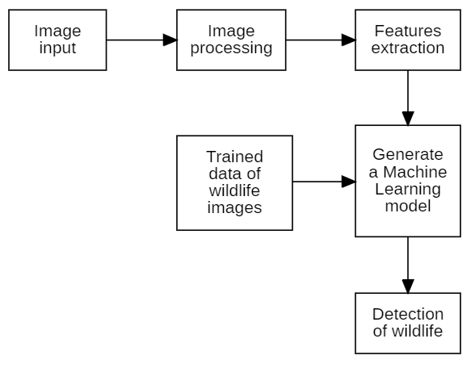
Architecture Diagram

Slide 11
Sreyas Institute of Engineering and Technology
An Autonomous Institution
Approved by AICTE, Affiliated to JNTUH
Accredited by NAAC-A Grade, NBA (CSE, ECE & ME) & ISO 9001:2015 Certified
REVIEW - II
A PROJECT
ON
BIO-EYE: AN ADVANCED WILDLIFE DETECTION FRAMEWORK
BACHELOR OF TECHNOLOGY
IN
COMPUTER SCIENCE AND ENGINEERING
BY
MAGANTI NIKHIL REDDY 21VE1A0538
PATNAM AKSHITHA REDDY 21VE1A0550
PAGADALA SANDEEPA 21VE1A0546
LINGAMGUNTA HEMANTH 21VE1A0537
ACADEMIC BATCH: (2021-2025)
Under the Guidance of
MRS. K. RAMYA LAXMI – Assistant Professor

Slide 12
Modules
1. Admin Module
Manages the system, including dataset updates, user roles, and permissions.
Oversees model training, retraining, and deployment for accurate species recognition.
Monitors system performance, ensuring smooth operation and generating detailed reports.

Slide 13
Modules
2. User Module
Provides tools for uploading camera trap images and viewing species identification results.
Offers interactive features like species information access and data visualization (maps, graphs).

Slide 14
Modules
3. Image Pre-processing and Segmentation Module
Segments images to isolate animals using advanced graph-cut algorithms.
Prepares images for recognition by normalizing size, color, and removing noise.
Adapts to environmental challenges such as low light or motion blur for better accuracy.

Slide 15
Modules
4. Deep Learning-Based Recognition Module
Leverages CNNs for automated species identification with high precision.
Incorporates transfer learning to adapt to new species or environmental conditions.
Outputs classification results with confidence scores for easy validation.

Slide 16
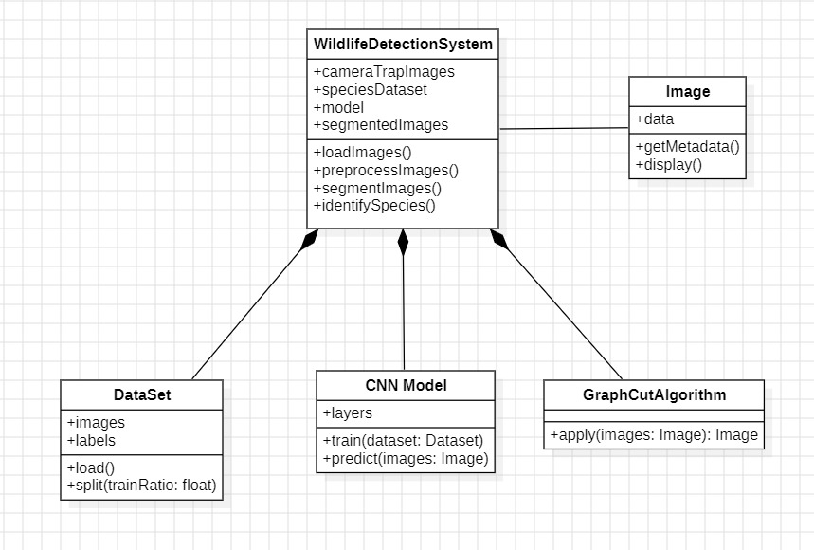
Class Diagram

Slide 17
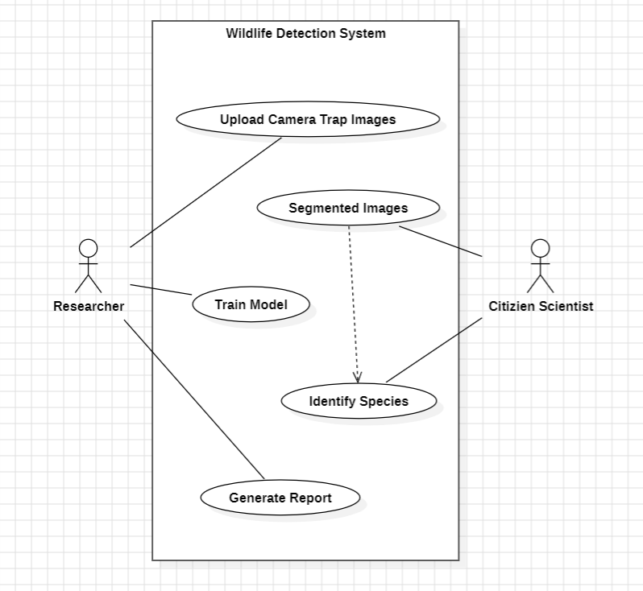
Use Case Diagram

Slide 18
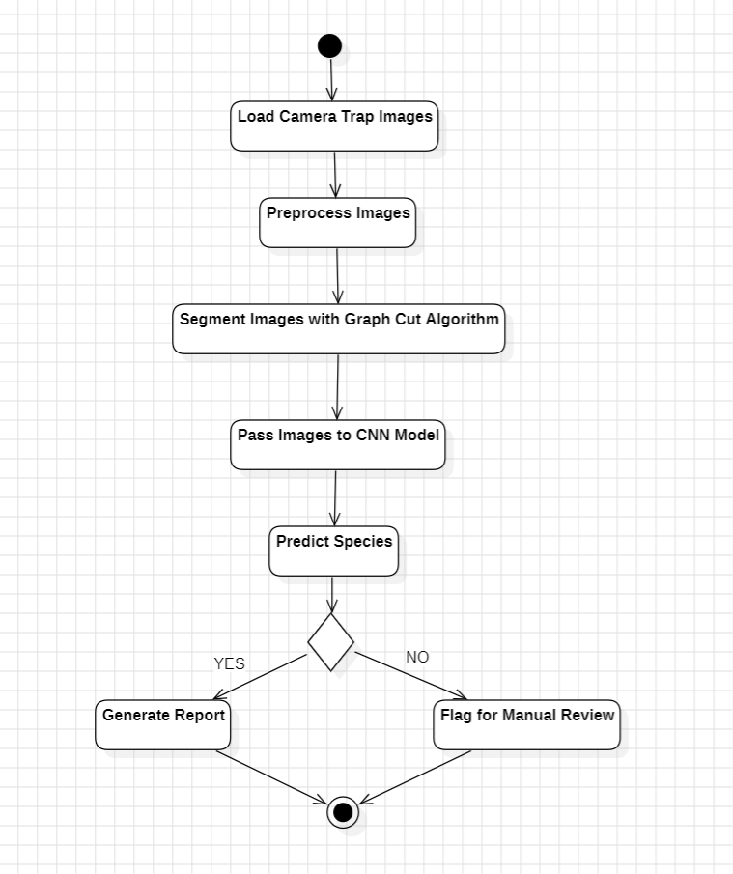
Activity Diagram

Slide 19
Sreyas Institute of Engineering and Technology
An Autonomous Institution
Approved by AICTE, Affiliated to JNTUH
Accredited by NAAC-A Grade, NBA (CSE, ECE & ME) & ISO 9001:2015 Certified
REVIEW – III
A PROJECT
ON
BIO-EYE: AN ADVANCED WILDLIFE DETECTION FRAMEWORK
BACHELOR OF TECHNOLOGY
IN
COMPUTER SCIENCE AND ENGINEERING
BY
MAGANTI NIKHIL REDDY 21VE1A0538
PATNAM AKSHITHA REDDY 21VE1A0550
PAGADALA SANDEEPA 21VE1A0546
LINGAMGUNTA HEMANTH 21VE1A0537
ACADEMIC BATCH: (2021-2025)
Under the Guidance of
MRS. K. RAMYA LAXMI – Assistant Professor

Slide 20
Testing and Its Types
Testing Definition: “Testing is the process of evaluating a system or its components to verify that it meets specified requirements and works as intended.”
Types of Testing:
Manual Testing: Performed without automated tools.
Automated Testing: Performed using scripts/tools.
Categories:
Functional Testing: Verifies the system’s Functionality (e.g: Unit Testing, Integration Testing).
Non-Functional Testing: Tests aspects like performance (e.g: Load Testing).
White-Box Testing: Focuses on internal code.
Black-Box Testing: Focuses on outputs without internal code knowledge.

Slide 21
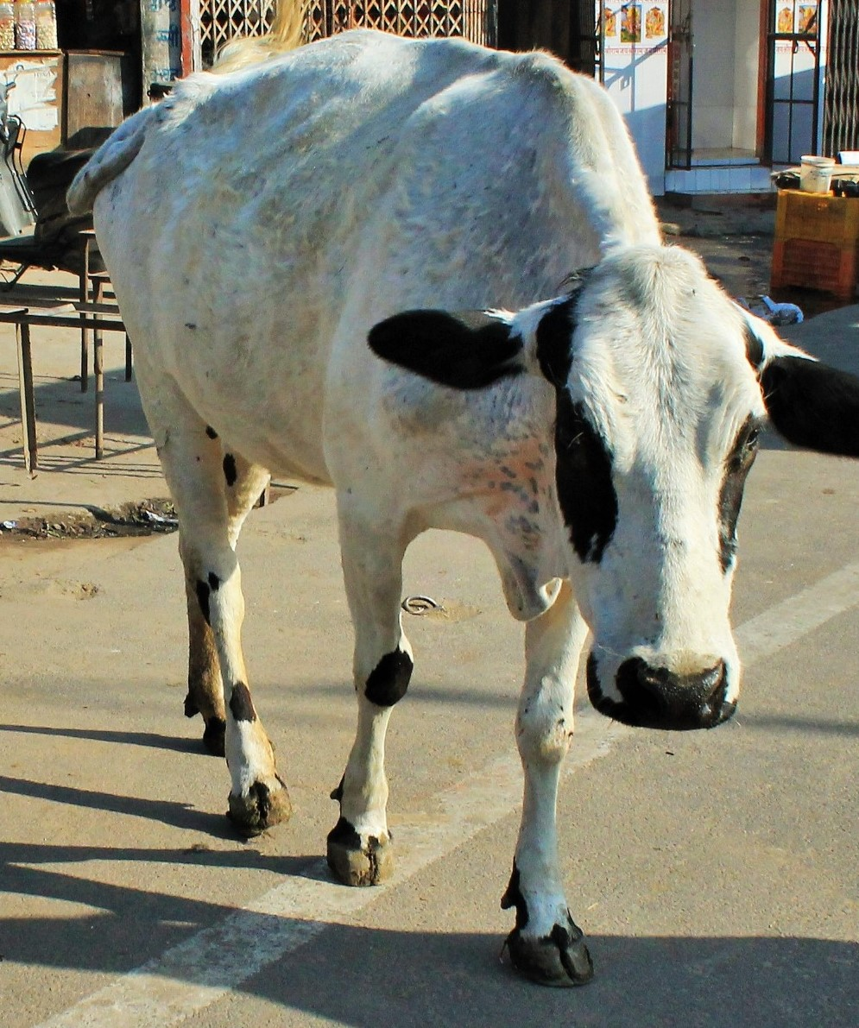
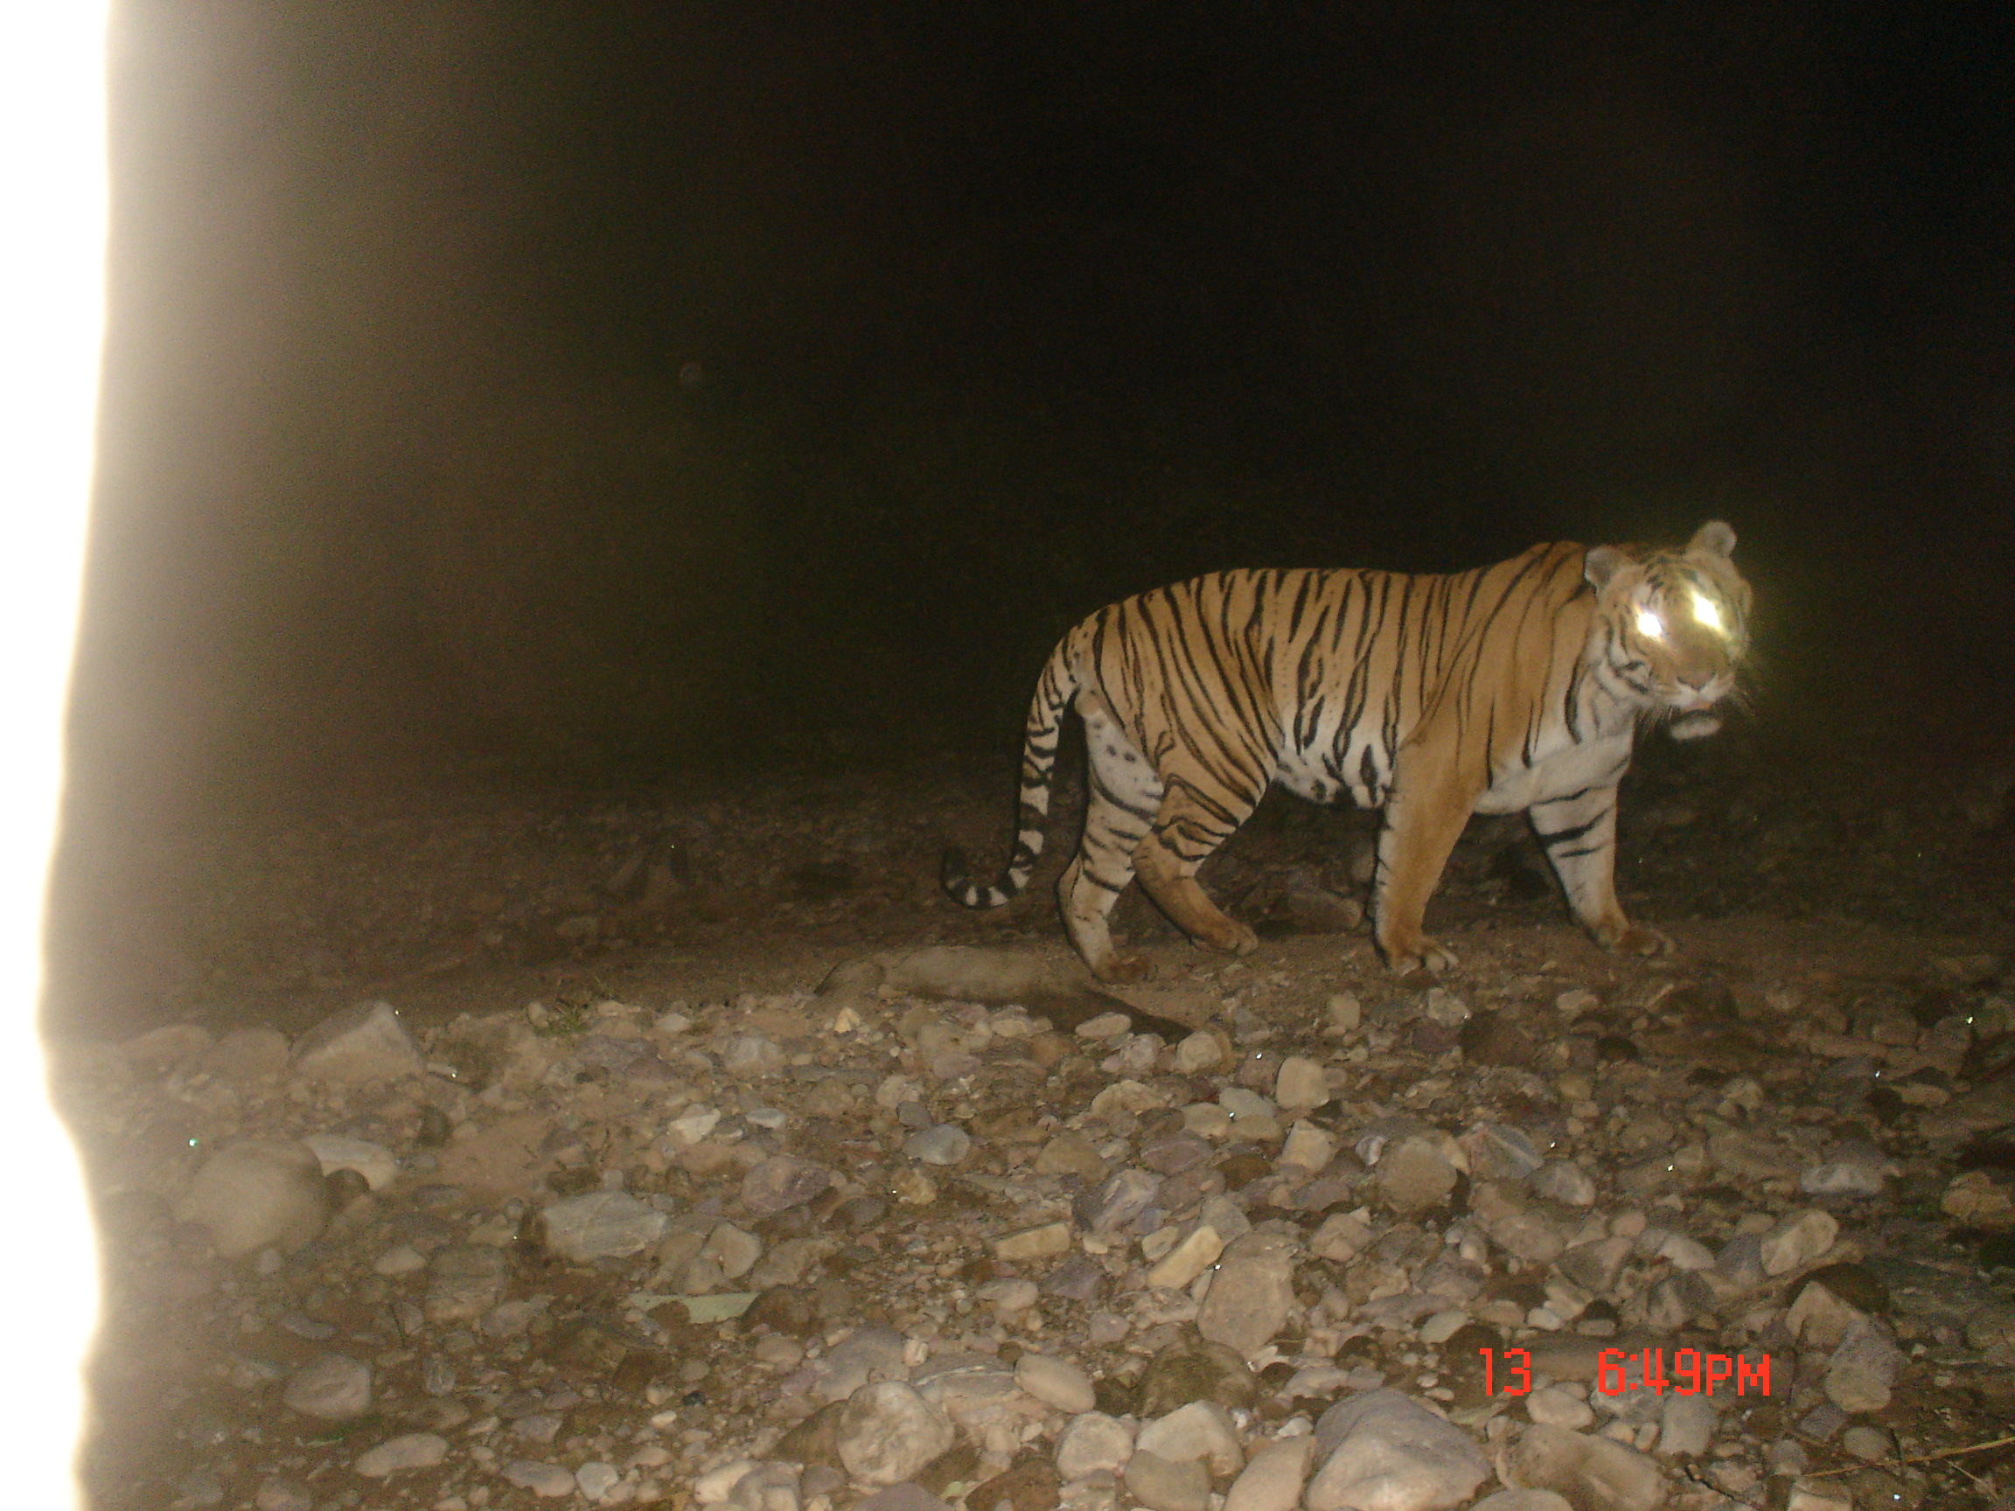
Test Cases:
ID | Test Description | Input | Expected Output | Actual Output | Status
TC-1 | Test with an image of a Cow |  | Predict as “Cow” | On Slide #23 | Pass
TC-2 | Test with an image of a Tiger |  | Predict as “Tiger” | On Slide #23 | Pass

Slide 22
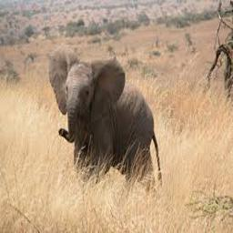
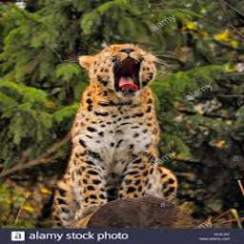
Test Cases:
ID | Test Description | Input | Expected Output | Actual Output | Status
TC-3 | Test with an image of an Elephant |  | Predict as “Elephant” | On Slide #24 | Pass
TC-4 | Test with an image of a Leopard |  | Predict as “Leopard” | On Slide #24 | Pass

Slide 23
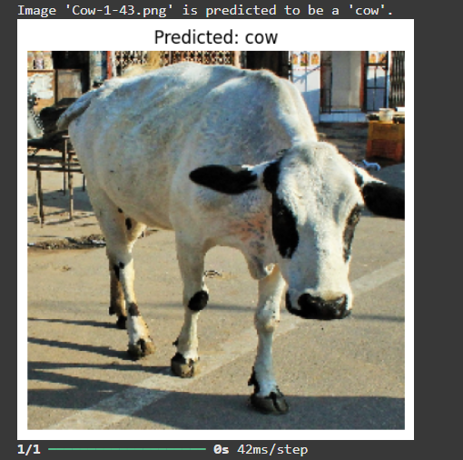
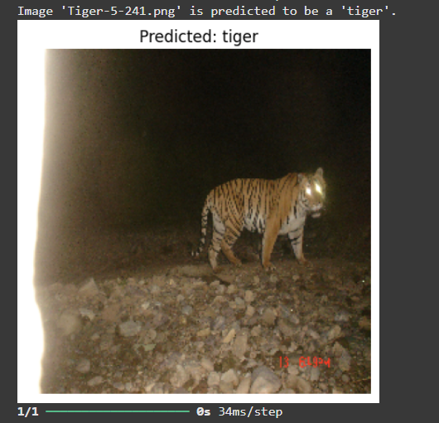
Output:
ID | TC-1 | TC-2
Text Description | Test with an image of a Cow | Test with an image of a Tiger
Output

Slide 24
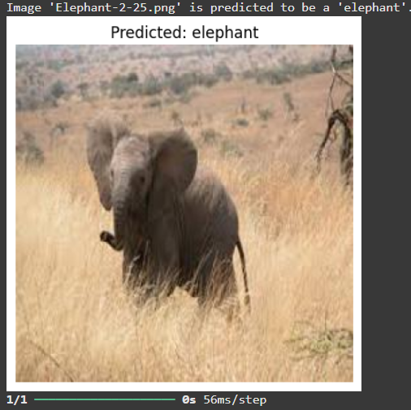
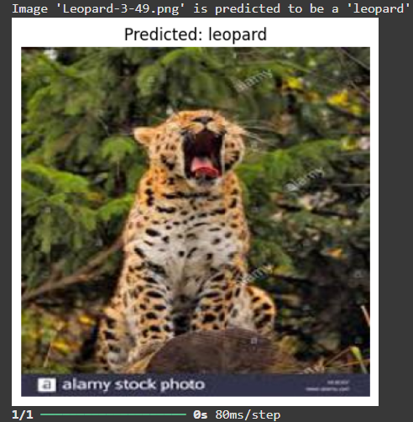
Output:
ID | TC-3 | TC-4
Text Description | Test with an image of an Elephant | Test with an image of a Leopard
Output

Slide 25
Limitations
Requires high-resolution images for accurate predictions.
Limited dataset size may impact model performance on rare or underrepresented species.
Basic algorithms may not handle complex extreme environmental variations.
Difficulty in achieving real-time processing due to simplified frameworks.

Slide 26
Future Scope or Enhancements
Generate synthetic data to handle rare species and balance datasets.
Add support for low-resolution or noisy images using advanced preprocessing.
Combine data from sensors like thermal, audio, and motion to improve detection.
Integrate ecological insights like migration patterns to support conservation decisions.

Slide 27
Conclusion
This project demonstrates significant potential in transforming ecological monitoring to automating species recognition with deep learning techniques.
By addressing traditional challenges like labor-intensive manual analysis, this system accelerates research efforts and enhances data-driven conservation strategies.
Despite current limitations, advancements in technology offer great potential for future development, helping conservationists make better decisions and supporting biodiversity and ecosystem health.

Slide 28
Thank You I welcome your inquiries and perspectives

